Slide 1

NETFLIX DATA ANALYSIS USING SQL

Slide 2
ABOUT THE PROJECT
This project focuses on analyzing and extracting insights from the Netflix dataset using SQL. The dataset contains various columns, including information about movies, TV shows, actors, directors, countries, release years, genres, and more. The primary objective is to use SQL queries to answer common business questions and perform data analysis, simulating how a data analyst would approach such a dataset.

Slide 3
PROJECT OVERVIEW
Objective: Analyze Netflix content based on movies, TV shows, ratings, genres, and more.
Dataset: Contains information about show_id, type, title, director, cast, country, date_added, release_year, rating, duration, listed_in, description
Approach: Use SQL to extract insights from the dataset.

Slide 4

Business Problems
1. Count the number of Movies vs TV Shows
2. Find the most common rating for movies and TV shows
3. List all movies released in a specific year (e.g., 2020)
4. Find the top 5 countries with the most content on Netflix
5. Identify the longest movie
6. Find content added in the last 5 years
7. Find all the movies/TV shows by director 'Rajiv Chilaka’!
8. List all TV shows with more than 5 seasons
9. Count the number of content items in each genre
10. Find each year and the average numbers of content release in India on Netflix. return top 5 year with highest avg content release!
11. List all movies that are documentaries
12. Find all content without a director

Slide 5
Business Problems
13. Find how many movies actor 'Salman Khan' appeared in last 10 years!
14. Categorize the content based on the presence of the keywords 'kill' and 'violence’ in the description field. Label content containing these keywords as 'Bad' and all other content as 'Good'. Count how many items fall into each category.
15. Find the oldest movie or TV show on Netflix.
16. Find the shortest movie on Netflix.
17. Calculate the total number of seasons for all TV shows combined.
18. Identify the average runtime for movies and TV shows.
19. Calculate the ratio of movies to TV shows for each year.
20. Calculate the average time gap between content additions on Netflix.

Slide 6
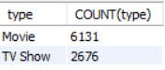
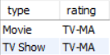
Solutions
Count the number of Movies vs TV Shows
SELECT
type, COUNT(type)
FROM
netflix
GROUP BY
type;
Find the most common rating for movies and TV shows
SELECT
type,rating
FROM
(SELECT
type,rating,
RANK() OVER(PARTITION BY type ORDER BY COUNT(*) DESC) AS ranking
FROM
netflix
GROUP BY
type,rating) AS T
WHERE ranking = 1;

Slide 7
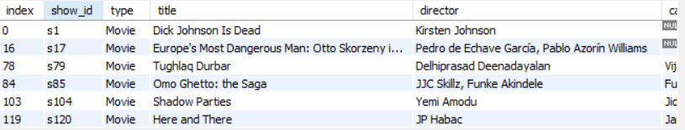
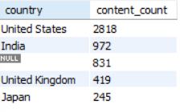
Solutions
3. List all movies released in a specific year (e.g., 2020)
SELECT *
FROM
netflix
WHERE
type = 'Movie’ AND release_year = 2020;
517 row(s) returned
Find the top 5 countries with the most content on Netflix
SELECT
country , COUNT(show_id) AS content_count
FROM
netflix
GROUP BY
country
ORDER BY
content_count DESC
LIMIT 5 ;

Slide 8
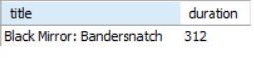
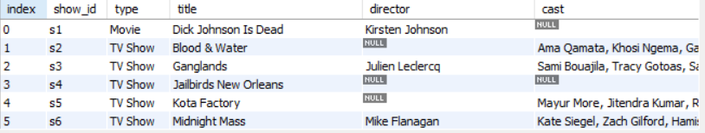
Solutions
5. Identify the longest movie
SELECT
title, CAST(SUBSTRING_INDEX(duration, ‘ ', 1) AS UNSIGNED) AS duration
FROM
netflix
WHERE
type = 'Movie’
ORDER BY
CAST(SUBSTRING_INDEX(duration, ' ', 1) AS UNSIGNED) DESC
LIMIT 1;
6. Find content added in the last 5 years
SELECT *
FROM
netflix 4163 row(s) returned
WHERE
STR_TO_DATE(date_added,'%M %d, %Y') >= DATE_SUB(DATE('2024-09-01'), INTERVAL 5 YEAR);

Slide 9
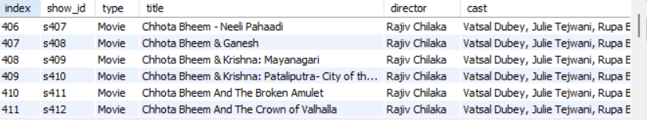
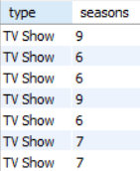
Solutions
7. Find all the movies/TV shows by director 'Rajiv Chilaka’!
SELECT *
FROM
netflix
WHERE
director LIKE ('%Rajiv Chilaka%’); 22 row(s) returned
List all TV shows with more than 5 seasons
SELECT *,
SUBSTRING_INDEX(duration,' ',1) AS seasons
FROM
netflix
WHERE
type = 'TV Show' AND CAST(SUBSTRING_INDEX(duration,' ',1)AS UNSIGNED) >5;
99 row(s) returned

Slide 10
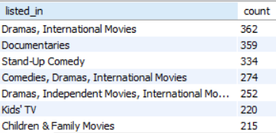
Solutions
9. Count the number of content items in each genre
SELECT
listed_in, COUNT(*) count
FROM
netflix
GROUP BY
listed_in 541 row(s) returned
ORDER BY
count DESC;

Slide 11
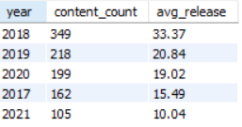
Solutions
10. Find each year and the average numbers of content release in India on Netflix. return top 5 year with highest avg content release!
SELECT
EXTRACT(YEAR FROM STR_TO_DATE(date_added, '%M %d, %Y')) AS year,
COUNT(show_id) AS content_count,
ROUND(COUNT(show_id)/ (SELECT
COUNT(show_id)
FROM
netflix WHERE
country LIKE ('%India%'))*100,2) AS avg_release
FROM netflix
WHERE
country LIKE ('%India%’)
GROUP BY
year
ORDER BY
content_count DESC LIMIT 5;

Slide 12
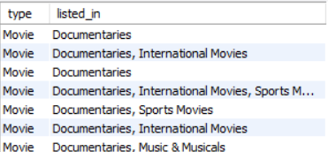
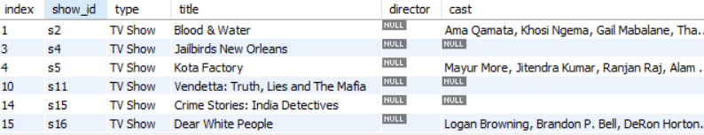
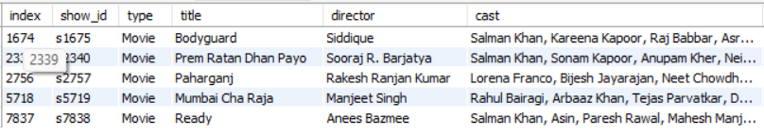
Solutions
11. List all movies that are documentaries
SELECT *
FROM
netflix
WHERE
type = 'Movie' AND listed_in LIKE ('%Documentaries%’);
12. Find all content without a director
SELECT *
FROM
netflix
WHERE
director IS NULL; 2634 row(s) returned
13. Find how many movies actor 'Salman Khan' appeared in last 10 years!
SELECT *
FROM
netflix
WHERE
cast LIKE '%Salman Khan%' AND release_year>YEAR(CURDATE()) - 15;

Slide 13
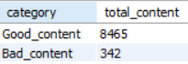
Solutions
14. Categorize the content based on the presence of the keywords 'kill' and 'violence’ in the description field. Label content containing these keywords as 'Bad' and all other content as 'Good'. Count how many items fall into each category.
WITH new_table
AS (SELECT
*, CASE
WHEN description LIKE '%Kill%' THEN 'Bad_content’
WHEN description LIKE '%Violence%' THEN 'Bad_content’
ELSE 'Good_content’
END AS category
FROM netflix )
SELECT
category, COUNT(*) AS total_content
FROM
new_table
GROUP BY
category;

Slide 14
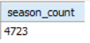
Solutions
15. Find the oldest movie or TV show on Netflix.
SELECT *
FROM
netflix
WHERE
release_year = (SELECT MIN(release_year) FROM netflix );
16. Find the shortest movie on Netflix.
SELECT *
FROM
netflix
WHERE
type='Movie' AND CAST(SUBSTRING_INDEX(duration,' ',1)AS UNSIGNED)=
(SELECT MIN(CAST(SUBSTRING_INDEX(duration,' ',1)AS UNSIGNED)) AS durations
FROM
netflix
WHERE
type = 'Movie' );
17. Calculate the total number of seasons for all TV shows combined.
SELECT
SUM(CAST(SUBSTRING_INDEX(duration,' ',1)AS UNSIGNED)) AS season_count
FROM netflix
WHERE type = 'TV Show';

Slide 15
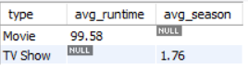
Solutions
18. Identify the average runtime for movies and TV shows.
SELECT
type, CASE
WHEN type = 'Movie' THEN ROUND(AVG(SUBSTRING_INDEX(duration,' ',1)),2)
END AS avg_runtime,
CASE
WHEN type = 'TV Show' THEN ROUND(AVG(SUBSTRING_INDEX(duration,' ',1)),2)
END AS avg_season
FROM
netflix
GROUP BY type;

Slide 16
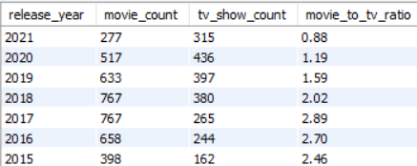
Solutions
19. Calculate the ratio of movies to TV shows for each year.
SELECT
release_ year, T.movie_count, T.tv_show_count, ROUND((T.movie_count/T.tv_show_count),2) AS movie_to_tv_ratio
FROM
(SELECT
release_year, COUNT(CASE WHEN type = 'Movie' THEN 1 END) AS movie_count,
COUNT(CASE WHEN type = 'TV Show' THEN 1 END) AS tv_show_count
FROM
netflix
GROUP BY
release_year) AS T 74 row(s) returned
ORDER BY
release_year DESC;

Slide 17
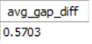
Solutions
20. Calculate the average time gap between content additions on Netflix.
WITH day_diff
AS (SELECT
STR_TO_DATE(date_added,'%M %d, %Y') AS formated_date,
LAG(STR_TO_DATE(date_added,'%M %d, %Y')) OVER (ORDER BY STR_TO_DATE(date_added,'%M %d, %Y')) AS previous_date
FROM
netflix
WHERE
date_added IS NOT NULL)
SELECT
AVG(DATEDIFF(formated_date, previous_date)) AS avg_gap_diff
FROM
day_diff
WHERE
previous_date IS NOT NULL

Slide 18
KEY TAKEAWAYS & BUSINESS RECOMMENDATIONS
Key Learnings:
Netflix prioritizes movies over TV shows but has increased TV content in recent years.
Top genres include Drama, Comedy, and Action.
Content ratings show a preference for mature audiences.
Most content comes from the USA, India, UK, Canada, and Japan.
Business Recommendations:
Expand TV show content in emerging markets.
Improve content diversity by adding more family-friendly content.
Optimize content release timing based on user engagement patterns.

Slide 19
CONCLUSION
Through this analysis, we uncovered valuable insights about Netflix’s content strategy. The data revealed trends in content distribution, popular genres, top-rated content, and country-wise contributions. Key findings include:
Movies dominate Netflix’s catalog but TV shows have grown significantly.
Mature-rated content (TV-MA) is the most common, suggesting a focus on adult audiences.
The USA, India, and the UK contribute the most content to Netflix.
Genres like Drama, Comedy, and Action are the most popular.
These insights can help Netflix optimize its content strategy, improve user engagement, and make data-driven decisions for future content acquisition.

Slide 20
THANK YOU

